Slide 1

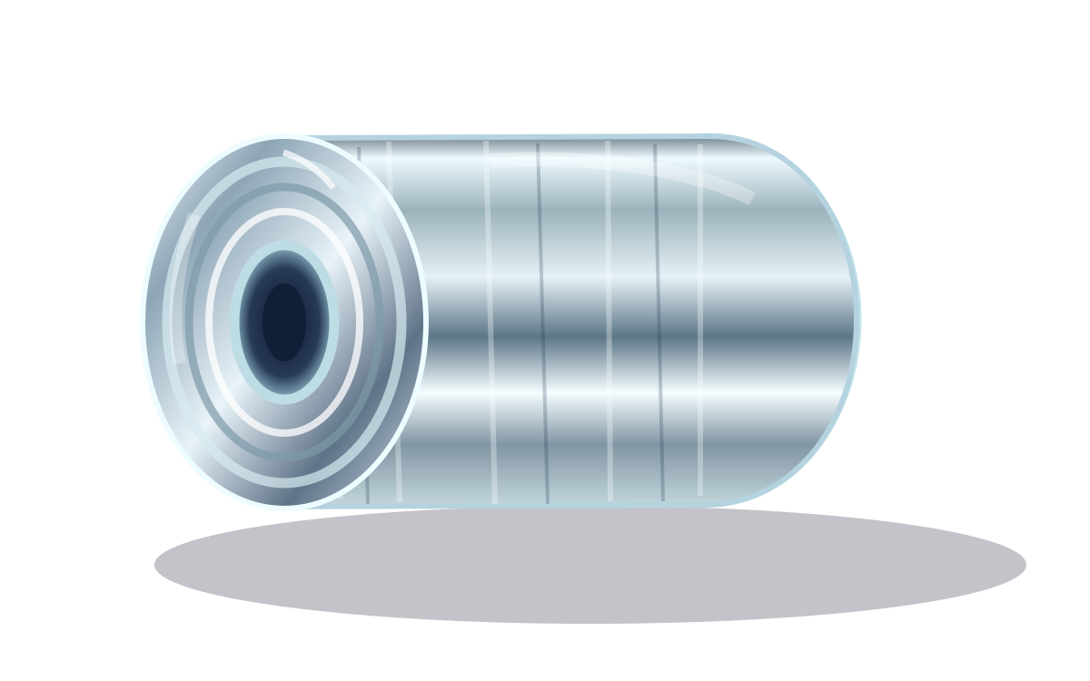
STRATEGY ✦ INNOVATION ✦ IMPACT
AURUM / ADVISORY
REIMAGINING
THE FUTURE
OF FOIL
Unlocking operational excellence and exponential value through an AI-powered transformation journey
NOVAFOIL MANUFACTURING
A fictional consulting case study
AURUM ADVISORY / PROJECT SILVER HORIZON
FICTIONAL CLIENT • ILLUSTRATIVE DATA
01 / 12

Slide 2





EXECUTIVE PERSPECTIVE
One bold ambition. Four extraordinary outcomes.
A holistic transformation can turn operational complexity into a sustainable competitive advantage.
+$24M
78%
5.5%
14 DAYS
VALUE CREATION
SMARTER OPERATIONS
LEANER PRODUCTION
FASTER SERVICE
Potential annual EBITDA upside at full run-rate
Target overall equipment effectiveness
Target rolling and converting scrap rate
Target quoted lead time for core SKUs
NORTH STAR → A future-ready, high-performance foil manufacturer
AURUM ADVISORY / PROJECT SILVER HORIZON
FICTIONAL CLIENT • ILLUSTRATIVE DATA
02 / 12

Slide 3









CLIENT AT A GLANCE
Meet NovaFoil: a high-potential business at an inflection point
Illustrative FY2026 baseline | Regional aluminum foil rolling and conversion manufacturer
$320M
3
7
$29M
REVENUE
PRODUCTION SITES
MANUFACTURING LINES
BASE EBITDA
THE COMPANY AT A GLANCE
Core products
Consumer wrap • Foodservice rolls • Flexible-packaging foil
THE BIG OPPORTUNITY
Operating profile
High-mix demand • Energy-intensive processes • Tight tolerances
Unlock the art of the possible.
Strategic aspiration
Move from a reactive plant network to a proactive value engine
AURUM ADVISORY / PROJECT SILVER HORIZON
FICTIONAL CLIENT • ILLUSTRATIVE DATA
03 / 12

Slide 4


THE BURNING PLATFORM
Four structural challenges are holding performance back
Across the production ecosystem, avoidable friction is eroding margin and customer experience.
01
02
03
04
68%
8.6%
7.2 HRS
21 DAYS
Underutilized Assets
Material Leakage
Slow Changeovers
Service Friction
Current OEE vs. a 78% target
Manufacturing scrap vs. 5.5% target
Average setup vs. 4.5-hour target
Average quoted lead time vs. 14-day target
THE OPPORTUNITY IS NOT JUST TO FIX ISSUES — IT IS TO REIMAGINE THE SYSTEM
AURUM ADVISORY / PROJECT SILVER HORIZON
FICTIONAL CLIENT • ILLUSTRATIVE DATA
04 / 12

Slide 5




VALUE CHAIN INTELLIGENCE
From fragmented operations to an intelligent foil ecosystem
We connect the dots across five production moments to create a single continuous-improvement engine.
➜
➜
➜
➜
FEEDSTOCK
COLD ROLLING
ANNEALING
SLITTING
DISPATCH
Coil quality
Run-speed stability
Cycle efficiency
Yield protection
On-time service
THE NOVAFOIL INTELLIGENCE LAYER
AI-READY DATA
REAL-TIME KPIs
PREDICTIVE INSIGHTS
One connected network. Infinite opportunities.
AURUM ADVISORY / PROJECT SILVER HORIZON
FICTIONAL CLIENT • ILLUSTRATIVE DATA
05 / 12

Slide 6


THE TRANSFORMATION ARCHITECTURE
Four strategic pillars. One exponential value engine.
A holistic, cross-functional model converts operational signals into measurable EBITDA opportunity.
01
02
03
04
THROUGHPUT INTELLIGENCE
ZERO-LOSS YIELD
ENERGY INTELLIGENCE
COMMERCIAL EXCELLENCE
AI-powered scheduling • reliability sprints
Loss tree analytics • optimized setup windows
Annealing optimization • demand balancing
Price waterfall • higher-value mix choices
+$8M
+$6M
+$4M
+$6M
TOTAL UPSIDE +$24M / YEAR
AURUM ADVISORY / PROJECT SILVER HORIZON
FICTIONAL CLIENT • ILLUSTRATIVE DATA
06 / 12

Slide 7



THE ENGINE OF CHANGE
The NovaFoil transformation flywheel
Insights become actions. Actions become outcomes. Outcomes make the system smarter.
SENSE
Connect operational signals
LEARN
DECIDE
Reinforce every win
Turn data into insight
FOIL OS
The intelligent factory
ACT
Deploy prioritized moves
TRANSFORM DATA INTO DECISIONS INTO DOLLARS
AURUM ADVISORY / PROJECT SILVER HORIZON
FICTIONAL CLIENT • ILLUSTRATIVE DATA
07 / 12

Slide 8
VALUE AT STAKE
A clear pathway from $29M to $53M EBITDA
Illustrative annual steady-state EBITDA bridge, assuming full implementation of the four workstreams.
+$6M
$53M
+$4M
+$6M
+$8M
$29M
FY26A
BASE
THROUGHPUT
SCRAP /
YIELD
ENERGY
PRICING /
MIX
TARGET
RUN-RATE
EBITDA MARGIN: 9.1% → 16.6%
AURUM ADVISORY / PROJECT SILVER HORIZON
FICTIONAL CLIENT • ILLUSTRATIVE DATA
08 / 12

Slide 9

PRIORITIZATION PLAYGROUND
Focus on the moves that move the needle
A hypothesis-led view of impact versus implementation feasibility (illustrative positioning).
STRATEGIC BETS
QUICK WINS ✦
HIGH IMPACT
Predictive
maintenance
Mill
scheduling
Scrap
root-cause
PRIORITY
MOVES
BUILD THE FOUNDATION
TACTICAL ENABLERS
Digital
twin
Energy
load shift
Win fast.
Scale smart.
Keep learning.
IMPLEMENTATION FEASIBILITY →
AURUM ADVISORY / PROJECT SILVER HORIZON
FICTIONAL CLIENT • ILLUSTRATIVE DATA
09 / 12

Slide 10




THE ACTIVATION ROADMAP
From vision to velocity in four seamless waves
Accelerate impact through sprint-based implementation, radical visibility and strong ownership.
01
02
03
04
DIAGNOSE
IGNITE
ACCELERATE
SUSTAIN
DAYS 0–30
➜
DAYS 31–90
➜
MONTHS 4–9
➜
MONTHS 10–18
Validate baseline
Map loss drivers
Align steering team
Pilot two lines
Launch daily cockpit
Capture proof points
Roll out playbooks
Optimize mix
Build capabilities
Standardize routines
Embed governance
Lock in value
EXECUTION PRINCIPLE → TEST • LEARN • SCALE • REPEAT
AURUM ADVISORY / PROJECT SILVER HORIZON
FICTIONAL CLIENT • ILLUSTRATIVE DATA
10 / 12

Slide 11
THE BUSINESS CASE
The economics of transformation are compelling
Illustrative investment case — benefits are target run-rates, not realized results.
$24M
+7.5 pp
$7M
3.4×
ANNUAL EBITDA UPSIDE
MARGIN EXPANSION
ONE-TIME ENABLEMENT
BENEFIT / INVESTMENT
Potential full-run-rate improvement
9.1% baseline → 16.6% potential
Systems, engineering and change capacity
Annual EBITDA upside ÷ one-time investment
A MORE RESILIENT, FUTURE-READY NOVAFOIL
Higher yield ✦ Smarter capacity ✦ Better service ✦ Stronger cash generation
Margin comparison uses the $320M illustrative revenue base; figures are rounded and not a forecast.
AURUM ADVISORY / PROJECT SILVER HORIZON
FICTIONAL CLIENT • ILLUSTRATIVE DATA
11 / 12

Slide 12
THE FUTURE IS ALREADY UNFOLDING
AURUM / ADVISORY
REINVENT.
REIMAGINE.
REIGNITE.
The future of foil starts with one bold decision.
ALIGN
ACTIVATE
ACCELERATE
Confirm value thesis
Launch pilot workstreams
Mobilize value realization
AURUM ADVISORY / PROJECT SILVER HORIZON
FICTIONAL CLIENT • ILLUSTRATIVE DATA
12 / 12

